Slide 1
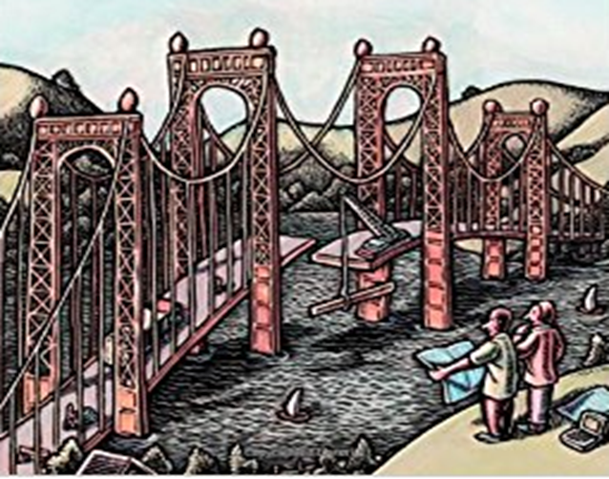
Behavioral Models
(Sequence Model)

Slide 2
Sequence Diagram (Event Diagram)
We have looked at the Activity model for bringing in the dynamic behavior or interactions of the classes. A sequence diagram depicts interaction between objects in a sequential order i.e. the order in which these interactions take place to support a use case.
Sequence diagrams are derived from Use Cases
Sequence diagrams are good for showing behavior sequence as seen by others

Slide 3
Scenarios
A scenario is a sequence of events that occurs during one particular execution of a system or a use case realization.
The scope of a scenario can vary;
it may include all events in the system,
or it may include only those events generated by certain objects.
A scenario can be displayed as a list of text statements.
A scenario contains messages between objects as well as activities performed by objects.
Each message transmits information from one object to another. Initially the statements can be described at a high level and may require multiple messages, which can get drilled down during later phases of design
Steps for creating a scenario would be
Identify the objects exchanging messages
Determine the sender and receiver of each messages and the sequence of messages

Slide 4
Scenario for session with an online stock broker
John Doe logs in.
System establishes secure communications.
Systems displays portfolio information.
John Doe enters a buy order for 100 shares of GE at the market price.
System verifies sufficient funds for purchase.
System displays confirmation screen with estimated cost.
John Doe confirms purchase.
System places order on securities exchange.
System displays transaction tracking number.
Jon Doe logs out.
System establishes insecure communication.
System displays good-bye screen.
Securities exchange reports results of trade.

Slide 5
Key Parts of a Sequence Diagram for a scenario
participant: object or entity from a class that acts in the diagram
message: communication between participant objects.
Action: A fragile rectangle can express it on a lifeline. These are also called the method-invocation boxes, and indicate that an object is part of an action. It starts when the message is received and ends when the object is done handling the message.
Axis in a sequence diagram:
Vertical: time (moving down signifies moving forward in time). This is also called the life line
Horizontal: which object/participant is acting (and sending messages)
participant
A:class
B:class
Message
Action
Life Line

Slide 6
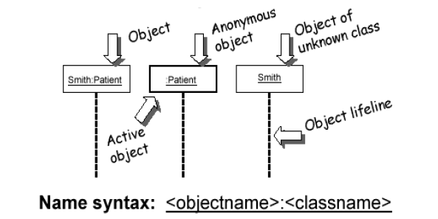
Representing Objects

Slide 7
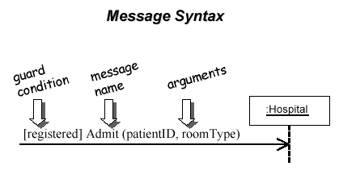
Representing Objects
message (method call) indicated by horizontal arrow to other object
write message name and arguments above arrow

Slide 8
Sequence Diagram
Shows the participants in an interaction and the sequence of messages among them
Depicts in a graphical manner the interaction of a system with its actors to perform all or part of a use case
Each object represented by a lifeline
Time moves vertically from top to bottom
Messages between objects (with parameters) shown by arrows
Can be at different levels of abstraction
Object, Module, Subsystem, System
Name:Class
A:class
B:class
Synchronous
Asynchronous
Transmission delayed
Condition
[condition] remove()
Iteration
Timeline
*[for each] remove()
Self-Call

Slide 9
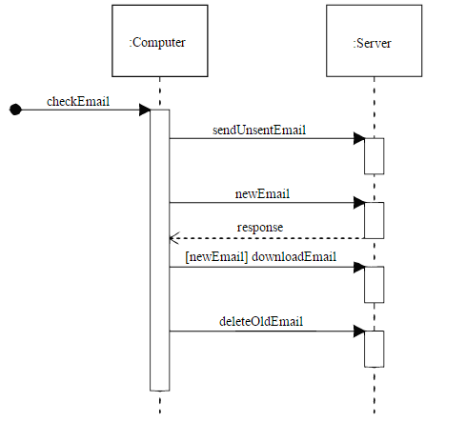
Sequence Diagram (Email Application)
participant
Lifeline
message
Action
condition

Slide 10
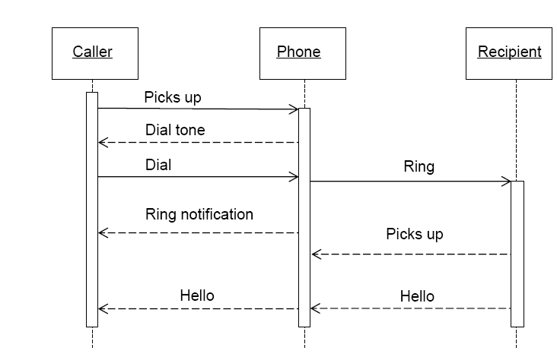
Sequence Diagram (Phone Calling Application)
Caller:class
Phone:class
Recipeint:class

Slide 11
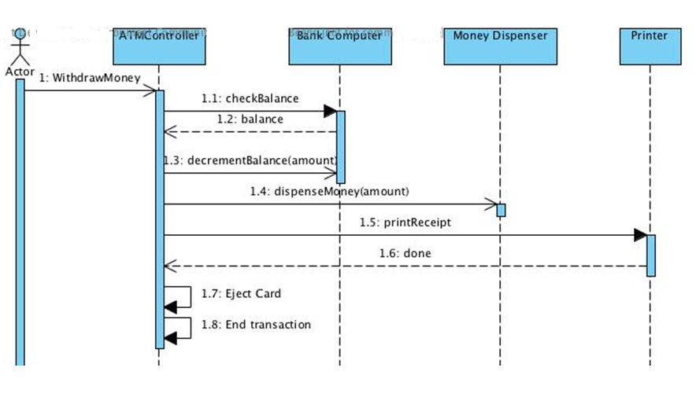
Asyn Message Example
There are problems here… what are they?
Synchronous message
Asynchronous message
Return message

Slide 12
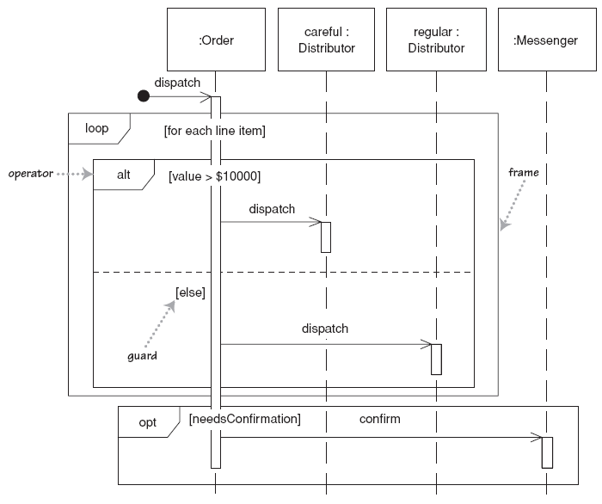
Indicating selection and loops
frame: box around part of a sequence diagram to indicate selection or loop
if -> (opt) [condition]
if/else -> (alt) [condition], separated by horizontal dashed line
loop -> (loop) [condition or items to loop over]

Slide 13
Passive Objects
Not constantly active
Activated only when called or cannot begin an operation
Passive objects can also be active parallelly
On return of control, becomes inactive
Period of time for objects execution shown as a thin rectangle
:Transaction
:Customer
:Rate
compute
commission()
service level (customer)
level
calculate commission (level, transaction)
commission

Slide 14
Transient Objects
c:Client
p: ODBCProxy
{transient}
create()
:Transaction
setAction(a, d, 0)
setValues(a,d,3,4)
committed
destroy()

Slide 15
Rules of thumb
Rarely use options,loops,alt/else
These constructs complicate a diagram and make them hard to read/interpret.
Frequently it is better to create multiple simple diagrams
Create sequence diagrams for use cases when it helps clarify and visualize a complex flow
Remember: the goal of UML is communication and understanding

Slide 16
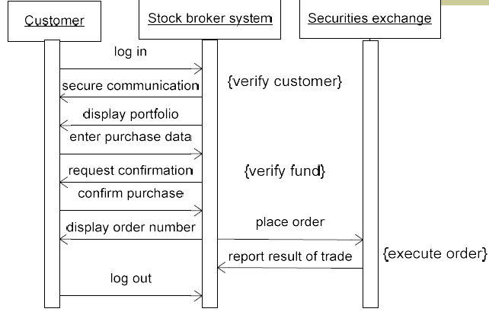
Example
Sequence diagram for a session with an online stock broker

Slide 17
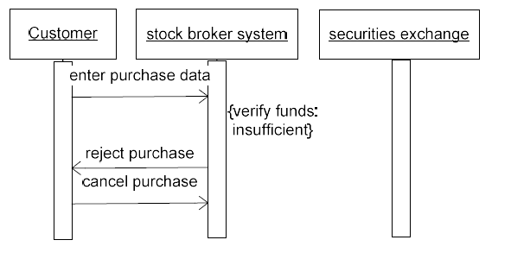
Sequence diagram for a stock purchase that fails

Slide 18
Exercise
Prepare sequence diagram for
Withdraw funds (retail banking)
Deposit funds (retail banking)
Transfer funds (internet banking)
For enhanced security, the payee must be added to a payee list
Procedure for adding a payee
User enters name, account number, and bank code (if different bank) of payee
System generates an authorization code and sends it to user’s email and cell phone
User enter authorization code to add payee

